Slide 1
Reasoning with Knowledge

Slide 2
Reasoning with Knowledge
Reasoning is the act of infering
new conclusions from a given KB

Slide 3
Reasoning with Knowledge
Reasoning is the act of infering new conclusions from it​​
Generally speaking, we have three main paradigms:
Logics, mainly Description Logics (a fragment of first-order logic)
Rule systems based on Horn logic (Logic Programming)
Production rule systems, with procedural style

Slide 4
Reasoning with Knowledge: Description Logics
DLs are based on concepts (unary predicates), roles (binary predicates), and individuals (constants).
DLs knowledge base consists of two parts:
  TBox . A terminological box (TBox) contains axioms about concept hierarchies and roles (relationships).
  ABox. An assertional box contains ground facts, i.e., instances of concepts and relationships.

Slide 5
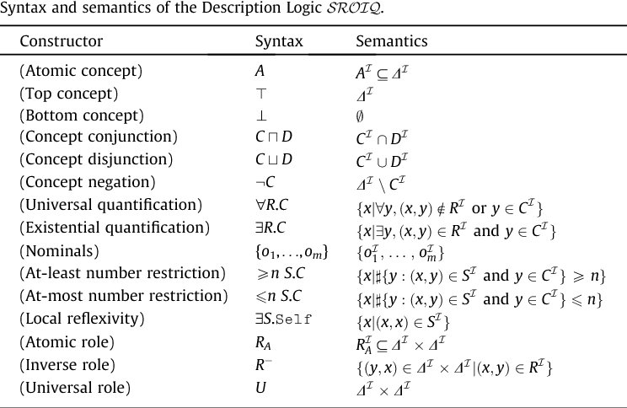
Reasoning with Knowledge: Description Logics

Slide 6
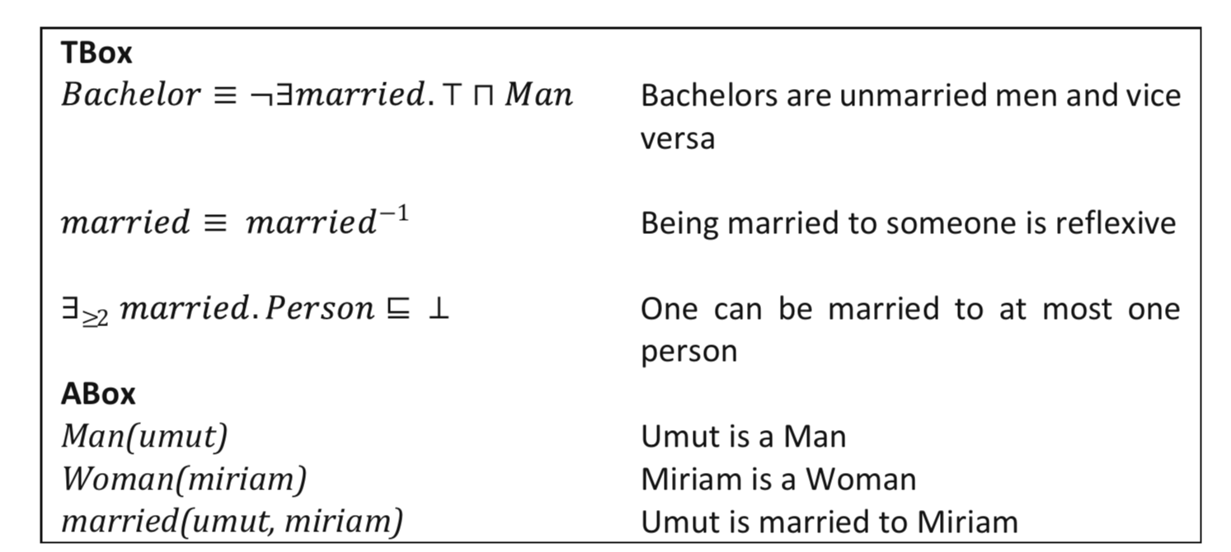
Reasoning with Knowledge: Description Logics

Slide 7
Reasoning with Knowledge: Description Logics
DLs are based on concepts (unary predicates), roles (binary predicates), and individuals (constants).
DLs knowledge base consists of two parts:
  TBox . A terminological box (TBox) contains axioms about concept hierarchies and roles (relationships).
  ABox. An assertional box contains ground facts, i.e., instances of concepts and relationships.
Like first-order logic, DLs are based on
  the Open-World Assumption (OWA)
  and does not have a Unique Name Assumption (UNA).

Slide 8
Reasoning with Knowledge: Description Logics
OWA:
  The absence of a statement does not imply that the statement is false.
  If a statement is not present in the KB, the answer to a query cannot automatically be “no/false”.
    The statement may simply be unknown.
  Therefore, if a statement is known to be false, this must be explicitly stated or logically inferred.
{
OWA: I don't know.
CWA: the restaurant is closed
Is the restaurant open?

Slide 9
Reasoning with Knowledge: Description Logics
UNA: Things that have different names (identifiers) are different.
  Example :
married(john, sally), married(john, sam).​
  UNA: sally and sam are different individual.
  WUNA: same and sally can refer to the same individual unless their distinctness is explicitly specified.
If married is functional property (at most one filler):
UNA: inconsistent KB
WUNA: sam and sally are the same individual

Slide 10
Reasoning with Knowledge: Logic Programming

Slide 11
Reasoning with Knowledge: Logic Programming
Logic programming is a paradigm in which a program is expressed using facts, rules,and queries (rather than a sequence of instructions), the underlying calculus determs the answers.​
Applications:
NASA's CLARISSA: A voice-controlled system developed to help astronauts navigate complex procedures aboard the International Space Station.
Telecom Ericsson AB: Ericsson Network Resource Manager (NRM) provides the capabilities for configuring and managing complex multivendor IP Backbone networks.
Biotech Pyrosequencing AB: SICS developed a dispensation order generation algorithm for Pyrosequencing's sequence analysis instruments, using constraint programming with SICStus.

Slide 12
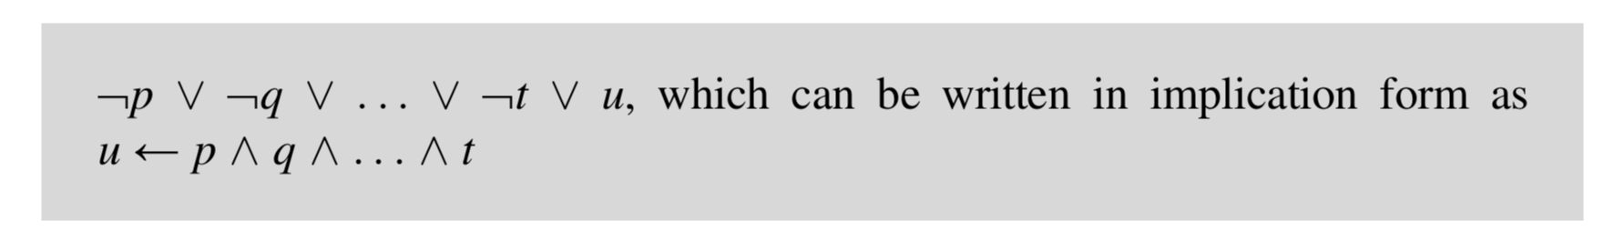
Reasoning with Knowledge: Logic Programming
Prolog is based on Horn clauses written in implication form.
A Horn clause is a formula constituted by a disjunction of literals with at most one positive literal.
  CWA (Closed World Assumption).
  UNA (Unique Name Assumption).
  Negation is admitted.

Slide 13
Reasoning with Knowledge: Logic Programming
A Prolog program is made by facts and rules:
  Rule consist of a head and a body written as implications
                head :- body
    The body implies the head.
    The body of a rule is a sequence of compound terms separated by a comma "," (AND) or a semicolon ;" (OR).
  Facts are rules without body.

Slide 14
Reasoning with Knowledge: Logic Programming
Example:
father_child(mike, tom).
father_child(mike, anna).
parent_child(X, Y) :- father_child(X, Y).
sibling(X, Y) :- parent_child(Z, X), parent_child(Z, Y), X \= Y.

Slide 15
Reasoning with Knowledge: Logic Programming
Prolog uses "resolution" in order to answer queries:
  it uses goals (queries);
  at each step, Prolog selects a goal :
    finds a matching rule using "unification",
    replaces the goal with the rule’s body.
  This process continues until all goals are satisfied, resulting in
    either success (the empty goal),
    or failure (no matching rule or fact can be found)

Slide 16
Reasoning with Knowledge: Logic Programming
Example:
father_child(mike, tom).
father_child(mike, anna).
parent_child(X, Y) :- father_child(X, Y).
sibling(X, Y) :- parent_child(Z, X), parent_child(Z, Y), X \= Y.
Query:
?- sibling(tom, anna).

Slide 17
Reasoning with Knowledge: Logic Programming
Step 1:
?- sibling(tom, anna).
parent_child(Z, tom),
parent_child(Z, anna),
tom \= anna.
sibling(X, Y) matches with sibling(tom, anna)
X=tom, Y= anna
Example:
father_child(mike, tom).
father_child(mike, anna).
parent_child(X, Y) :- father_child(X, Y).
parent_child(Z, tom).
parent_child(Z, anna).
tom \= anna.

Slide 18
Reasoning with Knowledge: Logic Programming
Step 2:
We prove that ?-parent_child(Z, tom), parent_child(Z, anna), tom/anna.
To prove parent_child(Z, tom) we use parent_child(X, Y) :- father_child(X, Y).
Example:
father_child(mike, tom).
father_child(mike, anna).
parent_child(X, Y) :- father_child(X, Y).
parent_child(Z, tom).
parent_child(Z, anna).
tom \= anna.

Slide 19
Reasoning with Knowledge: Logic Programming
Step 2:
We prove that ?-parent_child(Z, tom), parent_child(Z, anna), tom/anna.
To prove parent_child(Z, tom) we use parent_child(X, Y) :- father_child(X, Y).
Now Z = Mike
Example:
father_child(mike, tom).
father_child(mike, anna).
parent_child(Z, tom) :- father_child(Z, tom).
parent_child(Z, tom).
parent_child(Z, anna).
tom \= anna.

Slide 20
Reasoning with Knowledge: Logic Programming
Step 2:
We prove that ?-parent_child(Z, tom), parent_child(Z, anna), tom/anna.
To prove parent_child(Z, tom) we use parent_child(X, Y) :- father_child(X, Y).
Now Z = Mike
Example:
father_child(mike, tom).
father_child(mike, anna).
father_child(mike, tom).
parent_child(mike, tom).
parent_child(mike, anna).
tom \= anna.

Slide 21
Reasoning with Knowledge: Logic Programming
Step 3:
We prove that parent_child(mike, anna) and tom/anna. Already in KB.
Example:
father_child(mike, tom).
father_child(mike, anna).
father_child(mike, tom).
parent_child(mike, tom).
parent_child(mike, anna).
tom \= anna.
SUCCESS
?- sibling(tom, anna).

Slide 22
Reasoning with Knowledge: Production System Rules

Slide 23
Reasoning with Knowledge: Production System Rules
PRS are based on IF-THEN rules
PRS are constituted by:
  Knowledge Base, collection of production rules.
  Working Memory, facts about the current problem.
  Inference Engine, matches facts against rules and derives conclusions.
  MYCIN was an early medical expert system developed at Stanford in the 1970s to diagnose bacterial infections and recommend appropriate antimicrobial therapy.

Slide 24
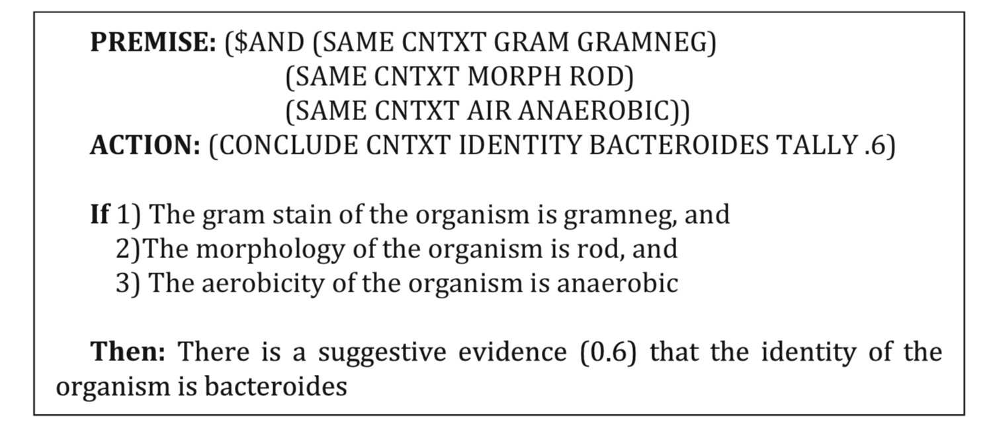
Reasoning with Knowledge: Production System Rules

